Slide 1
Access Control Lists
Introducing ACL Operation

Slide 2
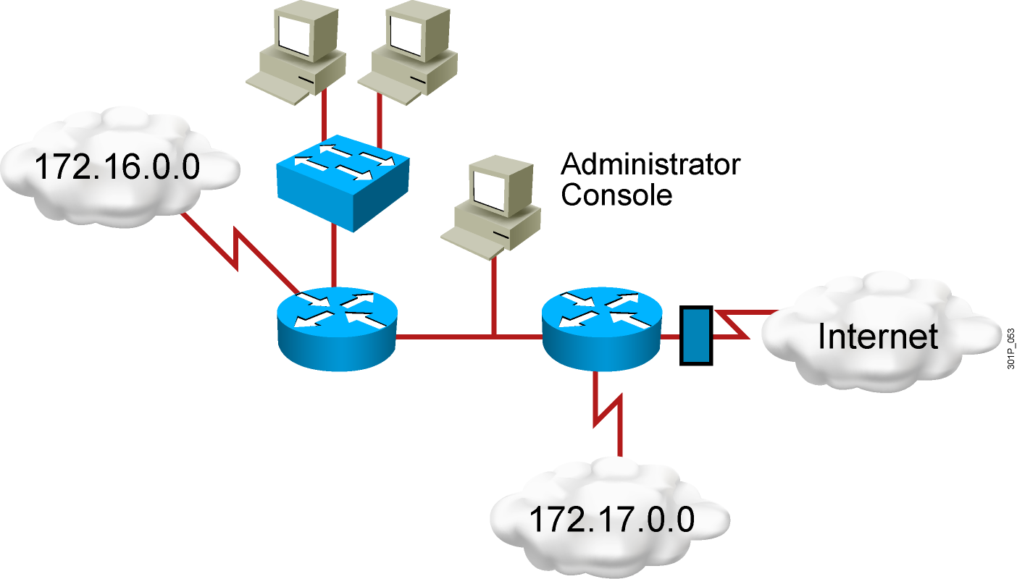
Why Use ACLs?
Filtering: Manage IP traffic by filtering packets passing through a router
Classification: Identify traffic for special handling
Notes:
Layer 2 of 2
Emphasize: An access list is a mechanism for identifying particular traffic. One application of an access list is for filtering traffic into or out of a router interface.

Slide 3
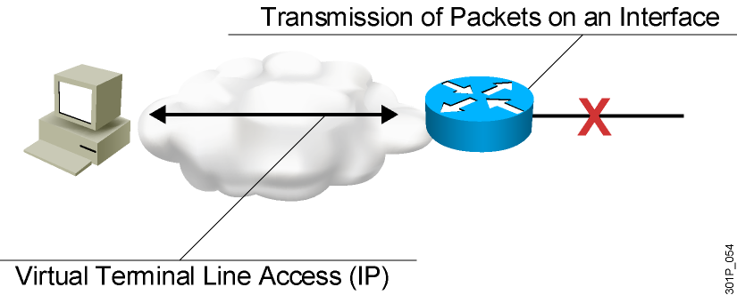
ACL Applications: Filtering
Permit or deny packets moving through the router.
Permit or deny vty access to or from the router.
Without ACLs, all packets could be transmitted to all parts of your network.
Notes:
Purpose: This figure illustrates common uses for IP access lists.
Emphasize: While this chapter focuses on IP access lists, the concept of access lists as mechanisms to control traffic in a network applies to all protocols.
Note: An improved security solution is the lock-and-key access feature, which is available only with IP extended access lists. Lock-and-key access allows you to set up dynamic access lists that grant access per user to a specific source/destination host through a user authentication process. You can allow user access through a firewall dynamically, without compromising security restrictions.
Transition: The following figure is the first of a three-layer build that presents other uses of access lists specific to Cisco IOS™ features.

Slide 4
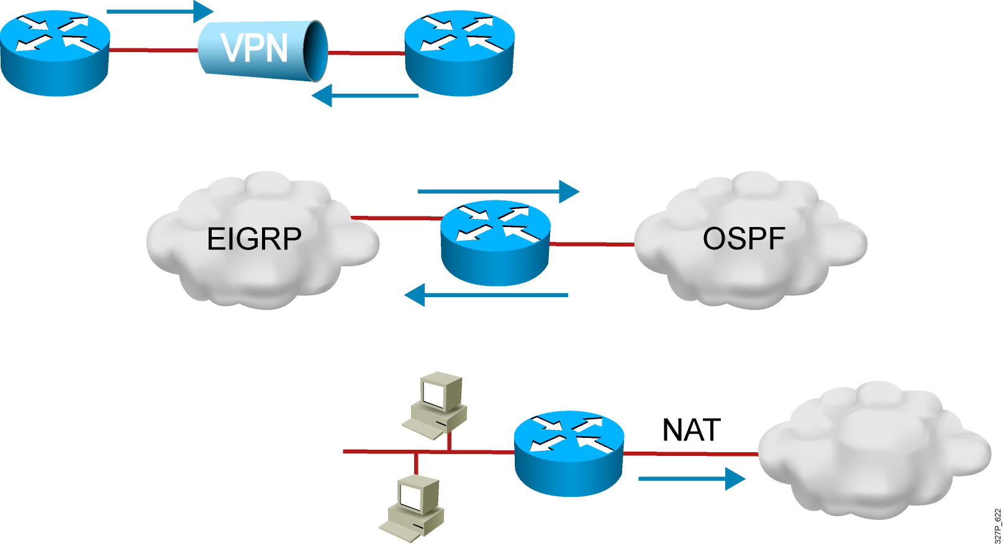
ACL Applications: Classification
Special handling for traffic based on packet tests
Notes:
Layer 3 of 3
Purpose: This figure is the last layer of the build for other uses of access lists.
Emphasize: Access lists are used to define input traffic for route filtering to restrict the contents of routing updates.
Transition: The following figure is a two-layer build to show the difference between inbound and outbound access lists.

Slide 5
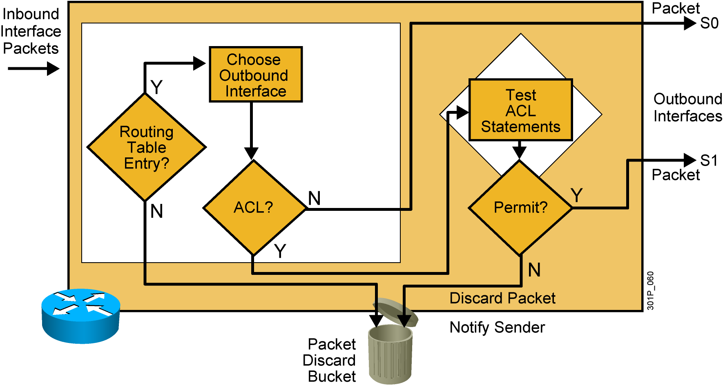
Outbound ACL Operation
  If no ACL statement matches, discard the packet.
Notes:
Layer 3 of 3
Purpose: Shows a deny result of the access list test.
Emphasize: Now the packet is discarded into the packet discard bucket. The unwanted packet has been denied access to the outbound interface.
The Notify Sender message shows a process like ICMP, returning an “administratively prohibited” message back to the sender.

Slide 6
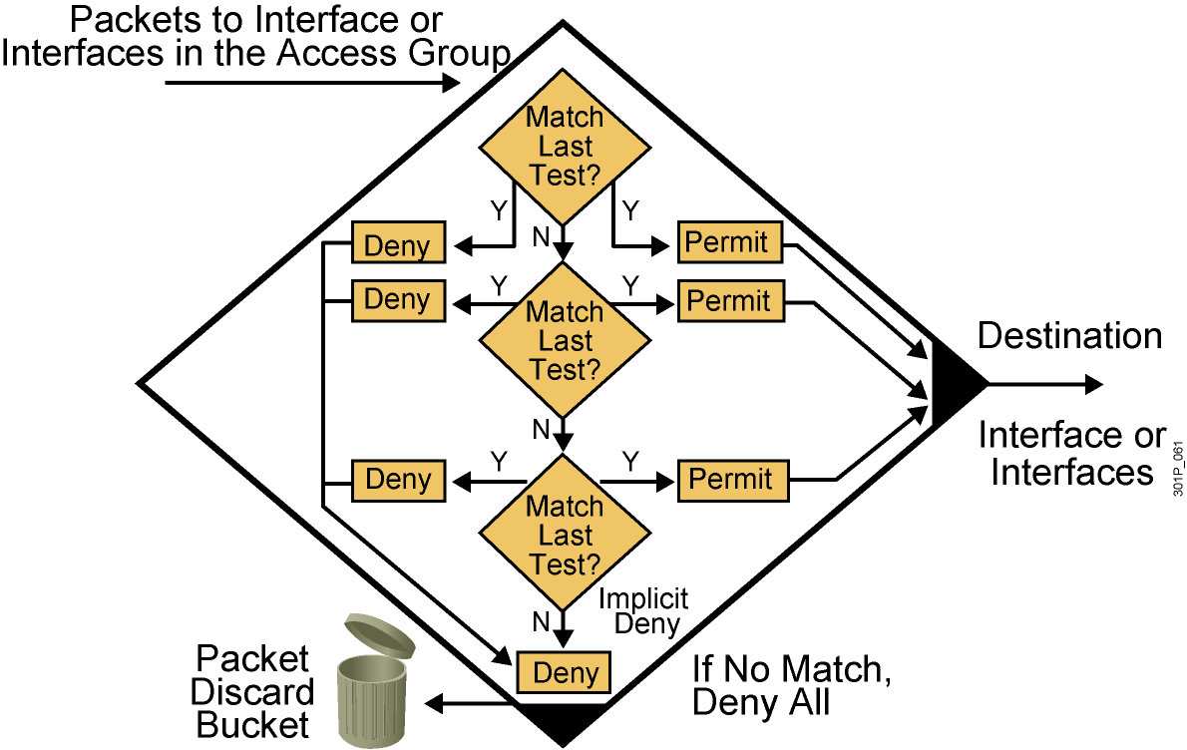
A List of Tests: Deny or Permit
Notes:
Layer 4 of 4
Purpose: Shows the implicit “deny all.”
Emphasize: Describe the final access list test to match any packets not covered by earlier access list statements. All remaining packets match the “Implicit Deny” and are discarded into the bit bucket.

Slide 7
Types of ACLs
Standard ACL
    Checks source address
    Generally permits or denies entire protocol suite
Extended ACL
    Checks source and destination address
    Generally permits or denies specific protocols and applications
Two methods used to identify standard and
extended ACLs:
    Numbered ACLs use a number for identification
    Named ACLs use a descriptive name or number for identification
Notes:
Layer 3 of 3
Purpose: Describe an inbound versus outbound access list on an interface.

Slide 8
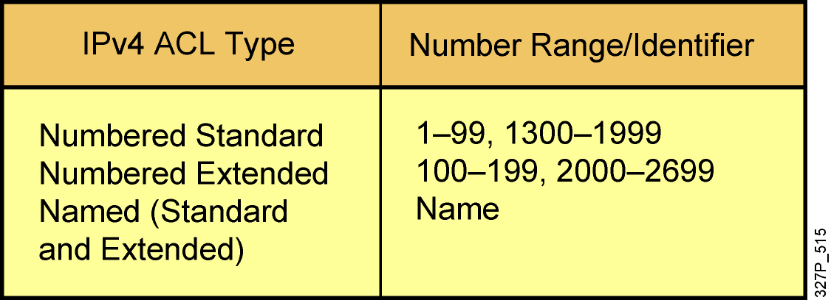
How to Identify ACLs
Numbered standard IPv4 lists (1–99) test conditions of all IP
packets for source addresses. Expanded range (1300–1999).
Numbered extended IPv4 lists (100–199) test conditions of source
and destination addresses, specific TCP/IP protocols, and destination
ports. Expanded range (2000–2699).
Named ACLs identify IP standard and extended ACLs with an
alphanumeric string (name).
Notes:
Layer 3 of 3
Emphasize: Layer 3—Adds the Novell IPX access lists covered in Chapter 11, “Configuring Novell IPX,” and the number ranges for these types of access lists. As of Release 11.2.4(F), IPX also supports named access lists.
Point out that number ranges generally allow 100 different access lists per type of protocol. When a given hundred-number range designates a standard access list, the rule is that the next hundred-number range is for extended access lists for that protocol.
Exceptions to the numbering classification scheme include AppleTalk and DECnet, where the same number range can identify various access list types.
For the most part, number ranges do not overlap between different protocols.
Note: With Cisco IOS 12.0, the IP access-lists range has been expanded to also include:
<1300-1999> IP standard access list (expanded range)
<2000-2699> IP extended access list (expanded range)

Slide 9
IP Access List Entry Sequence Numbering
  Requires Cisco IOS Release 12.3
  Allows you to edit the order of ACL statements using sequence numbers
    In software earlier than Cisco IOS Release 12.3, a text editor is used to create ACL statements, then the statements are copied into the router in the correct order.
  Allows you to remove a single ACL statement from the list using a sequence number
    With named ACLs in software earlier than Cisco IOS Release 12.3, you must use no {deny | permit} protocol source source-wildcard destination destination-wildcard to remove an individual statement.
    With numbered ACLs in software earlier than Cisco IOS Release 12.3, you must remove the entire ACL to remove a single ACL statement.

Slide 10
ACL Configuration Guidelines
  Standard or extended indicates what can be filtered.
  Only one ACL per interface, per protocol, and per direction is allowed.
  The order of ACL statements controls testing, therefore, the most specific statements go at the top of the list.
  The last ACL test is always an implicit deny everything else statement, so every list needs at least one permit statement.
  ACLs are created globally and then applied to interfaces for inbound or outbound traffic.
  An ACL can filter traffic going through the router, or traffic to and from the router, depending on how it is applied.
  When placing ACLs in the network:
    Place extended ACLs close to the source
    Place standard ACLs close to the destination

Slide 11
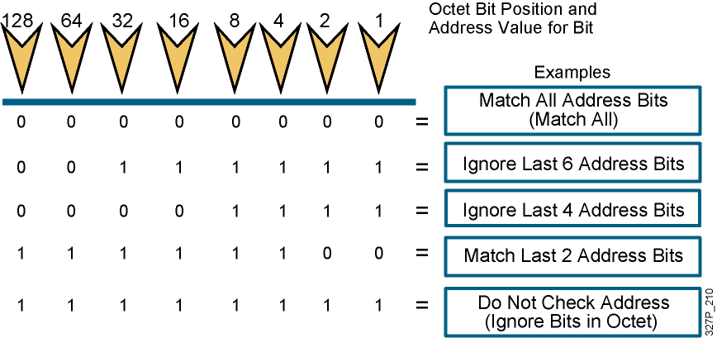
Wildcard Bits: How to Check the Corresponding Address Bits
  0 means to match the value of the corresponding address bit
  1 means to ignore the value of the corresponding address bit
Notes:
Purpose: This graphic describes the binary wildcard masking process.
Emphasize: Introduce the wildcard bit process. Tell students that the wildcard bit matching process is different than the IP subnet addressing mask covered earlier.
Illustrate how wildcard masking works using the examples shown in the graphic table.
The term wildcard masking is a nickname for this access list mask-bit-matching process. This nickname comes from an analogy of a wildcard that matches any other card in a poker game.
Emphasize the contrast between wildcard masks and subnet masks, stated in the Student Guide note. The confusion over wildcard and subnet masks can be a key obstacle to learning if students fail to understand the different uses of binary 0 and binary 1 in the two mask types.
Point out that the 1 bits in a wildcard mask need not be contiguous, while the 1 bits in a subnet mask need to be contiguous.
Wildcard is like the DOS “*” character.

Slide 12
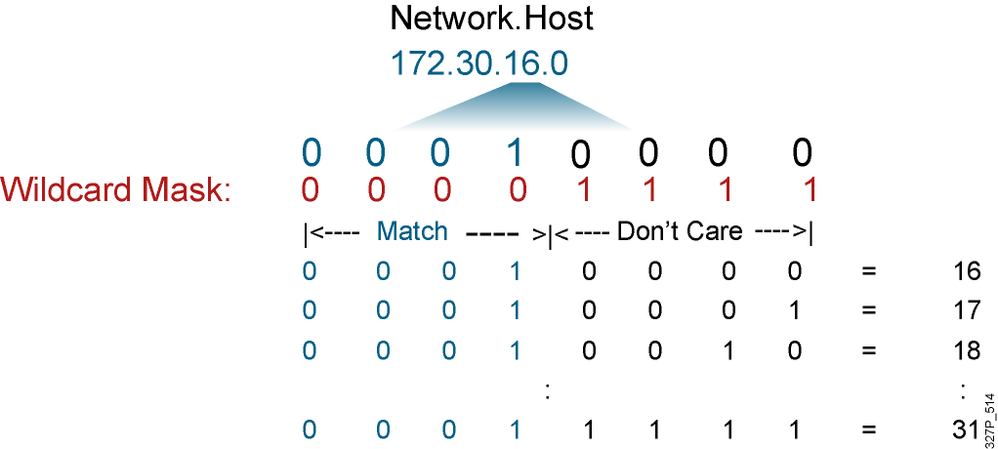
Wildcard Bits to Match IP Subnets
Match for IP subnets 172.30.16.0/24 to 172.30.31.0/24.
Address and wildcard mask:
172.30.16.0 0.0.15.255
Notes:
Purpose: This slide describes an example of how wildcard mask bits will match all hosts on subnets 172.30.16.0/24 to 172.30.31.0/24.
Emphasize: This process requires a thorough understanding of binary numbering, what values to use in the power of two bit positions, and how to convert a number from decimal to binary.
If some of your students seem to lack this understanding, tell them that responsibility for complex access list design is an advanced configuration skill. Later, this course offers a hands-on lab to allow practice designing simple access lists.
If you feel that your students need another example to improve their understanding of the process, prepare another example as a chalk talk. Consider having students volunteer to help as you solve your own example that lines up the binary bits of the address and the binary bits of the wildcard mask.

Slide 13
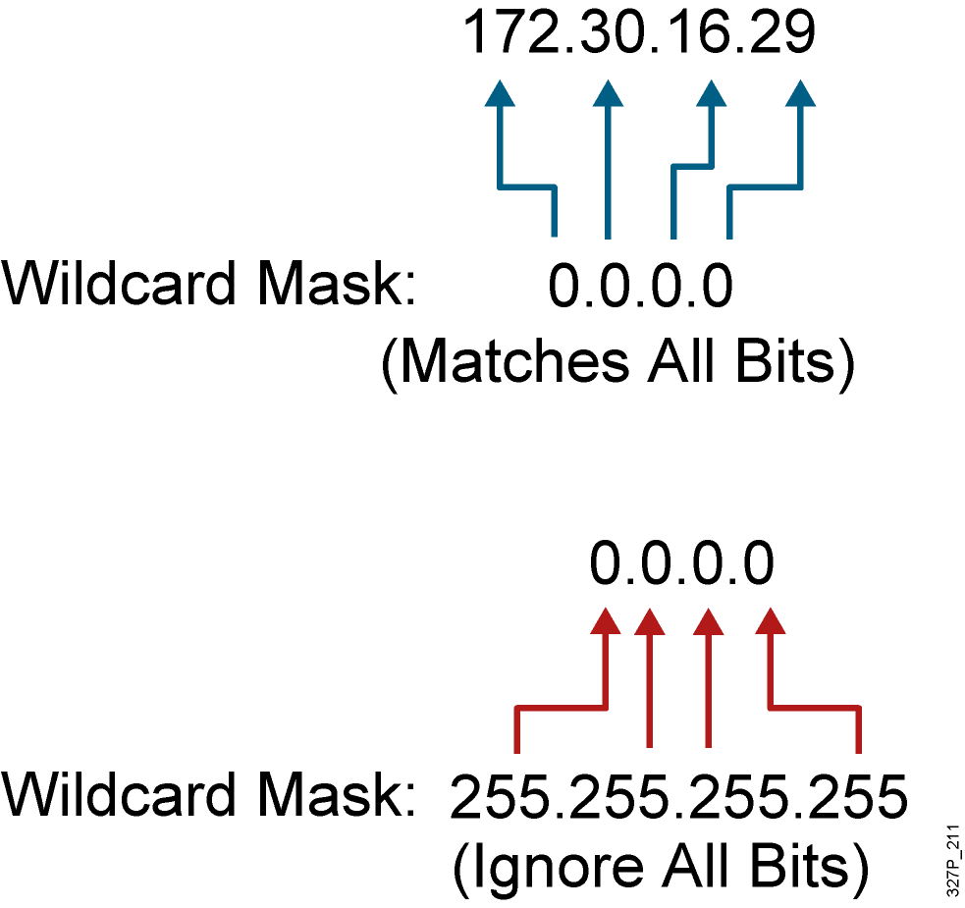
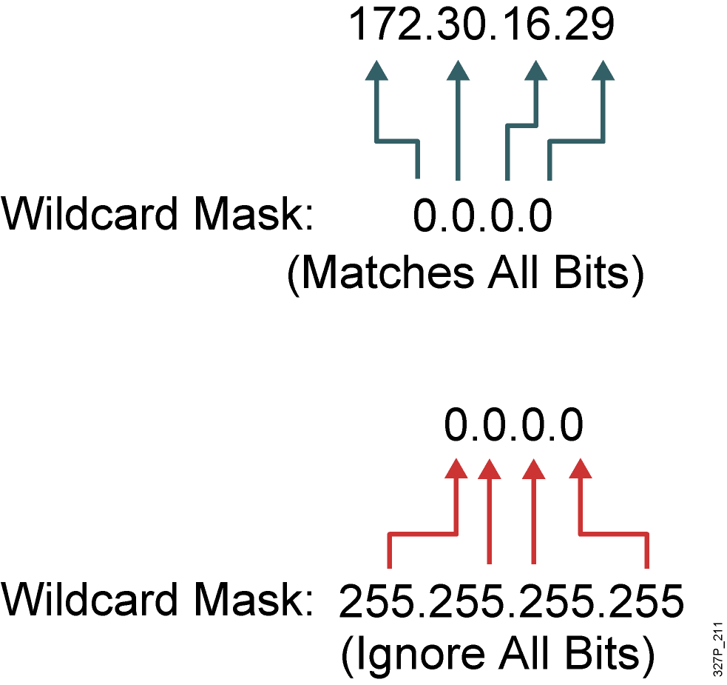
Wildcard Bit Mask Abbreviations
172.30.16.29 0.0.0.0 matches
all of the address bits
Abbreviate this wildcard mask
using the IP address preceded
by the keyword host
(host 172.30.16.29)
0.0.0.0 255.255.255.255
ignores all address bits
Abbreviate expression
with the keyword any
Notes:
Purpose: This graphic shows students how to use the host abbreviation in the extended access list wildcard mask.
Emphasize: This abbreviation means check the bit value in all bit positions, which has the effect of matching only the specified IP host address in all bit positions.

Slide 14
Access Control Lists
Configuring and Troubleshooting ACLs

Slide 15
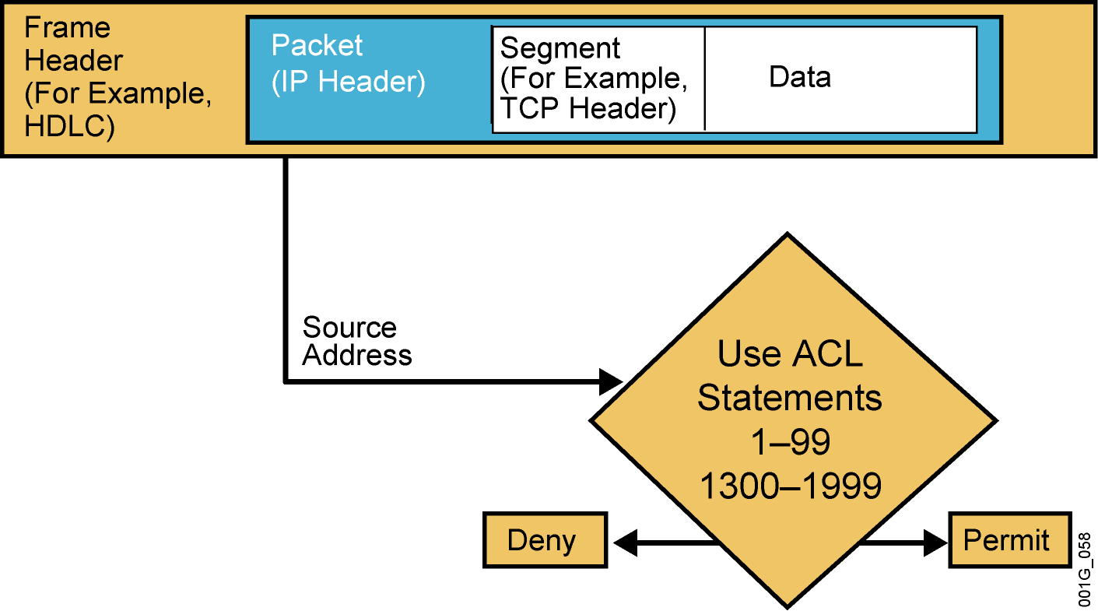
Testing Packets with
Numbered Standard IPv4 ACLs
Notes:
Purpose: This graphic gives an overview of the type of TCP/IP packet tests that standard access lists can filter. It uses the encapsulation graphic and diamond decision graphic to remind students of material presented earlier in this course.

Slide 16
Numbered Standard IPv4 ACL Configuration
RouterX(config)#
access-list access-list-number {permit | deny | remark} source [mask]
Uses 1 to 99 for the access-list-number.
The first entry is assigned a sequence number of 10, and successive entries
are incremented by 10.
Default wildcard mask is 0.0.0.0 (only standard ACL).
no access-list access-list-number removes the entire ACL.
remark lets you add a description to the ACL.
RouterX(config-if)#
ip access-group access-list-number {in | out}
Activates the list on an interface.
Sets inbound or outbound testing.
no ip access-group access-list-number {in | out} removes the ACL from the interface.
Notes:
Layer 2 of 2
Purpose: This layer shows the ip access-group command.
Emphasize: The ip access-group command links an access list to an interface. Only one access list per interface, per direction, per protocol is allowed.
The ip access-group field descriptions are as follows:
list—Number of the access list to be linked to this interface.
direction—Default is outbound.
Note: Create the access list first before applying it to the interface. If it is applied to the interface before it is created, the action will be to permit all traffic. However, as soon as you create the first statement in the access list, the access list will be active on the interface. Since there is the implicit deny all at the end of every access list, the access list may cause most traffic to be blocked on the interface.
To remove an access list, remove it from all the interfaces first, then remove the access list. In older versions of Cisco IOS, removing the access list without removing it from the interface can cause problems.

Slide 17
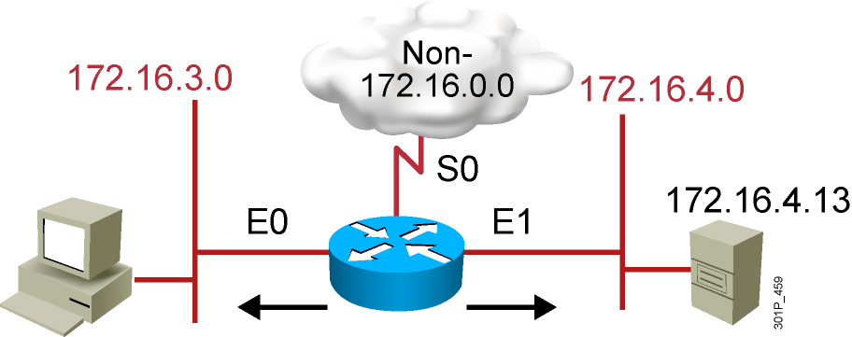
Numbered Standard IPv4 ACL
Example 1
RouterX(config)# access-list 1 permit 172.16.0.0 0.0.255.255
(implicit deny all - not visible in the list)
(access-list 1 deny 0.0.0.0 255.255.255.255)
RouterX(config)# interface ethernet 0
RouterX(config-if)# ip access-group 1 out
RouterX(config)# interface ethernet 1
RouterX(config-if)# ip access-group 1 out
Permit my network only
Notes:
Layer 2 of 2
Emphasize: Because of the implicit deny all, all non-172.16.x.x traffic is blocked going out E0 and E1.
Note: The red arrows represent the access list is applied as an outbound access list.

Slide 18
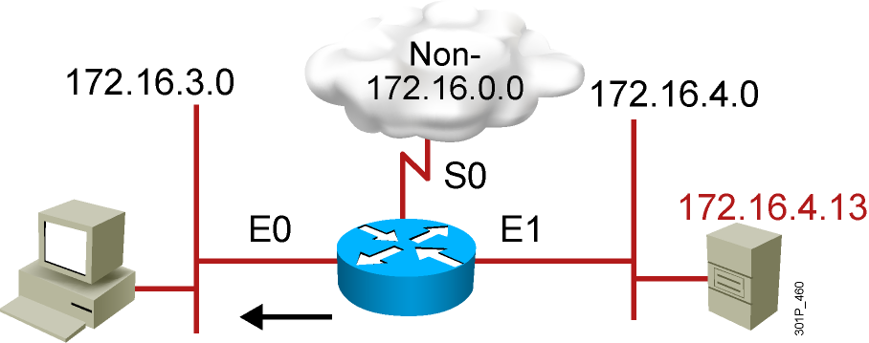
Numbered Standard IPv4 ACL
Example 2
RouterX(config)# access-list 1 deny 172.16.4.13 0.0.0.0
RouterX(config)# access-list 1 permit 0.0.0.0 255.255.255.255
(implicit deny all)
(access-list 1 deny 0.0.0.0 255.255.255.255)
RouterX(config)# interface ethernet 0
RouterX(config-if)# ip access-group 1 out
Deny a specific host
Notes:
Layer 3 of 3
Emphasize: Only host 172.16.4.13 is blocked from going out on E0 to subnet 172.16.3.0.
Ask the students what will happen if the access list is placed as an input access list on E1 instead. Host 172.16.4.13 will be blocked from going out to the non-172.16.0.0 cloud, as well as to subnet 172.16.3.0.
Note: The red arrows represent the access list is applied as an outbound access list.

Slide 19
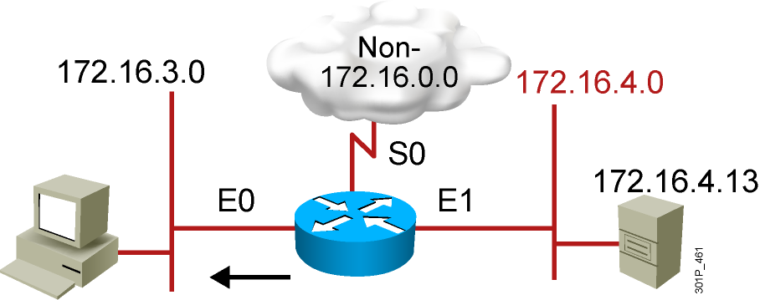
Numbered Standard IPv4 ACL
Example 3
RouterX(config)# access-list 1 deny 172.16.4.0 0.0.0.255
RouterX(config)# access-list 1 permit any
(implicit deny all)
(access-list 1 deny 0.0.0.0 255.255.255.255)
RouterX(config)# interface ethernet 0
RouterX(config-if)# ip access-group 1 out
Deny a specific subnet
Notes:
Layer 2 of 2
Emphasize: All hosts on subnet 172.16.4.0 are blocked from going out on E0 to subnet 172.16.3.0.
Note: The red arrows represent the access list is applied as an outbound access list.

Slide 20
Standard ACLs to Control vty Access
RouterX(config-line)#
access-class access-list-number {in | out}
Restricts incoming or outgoing connections between a particular
vty and the addresses in an ACL
Example:
access-list 12 permit 192.168.1.0 0.0.0.255
(implicit deny any)
!
line vty 0 4
access-class 12 in
Permits only hosts in network 192.168.1.0 0.0.0.255 to connect
to the router vty lines
Notes:
Purpose: This example shows how to restrict incoming Telnet sessions to the router’s vty ports.
Emphasize: The access class is applied as an input filter.
Note: Ask the student about the effect of changing the direction of the access class to outbound instead of inbound.
Now the router can accept incoming Telnet sessions to its vty ports from all hosts, but will block outgoing Telnet sessions from its vty ports to all hosts except hosts in network 192.89.55.0.
Once a user is Telneted into a router’s vty port, the outbound access-class filter will prevent the user from Telneting to other hosts as specified by the standard access list.
Remember, when an access list is applied to an interface, it only blocks or permits traffic going through the router, it does not block or permit traffic initiated from the router itself.

Slide 21
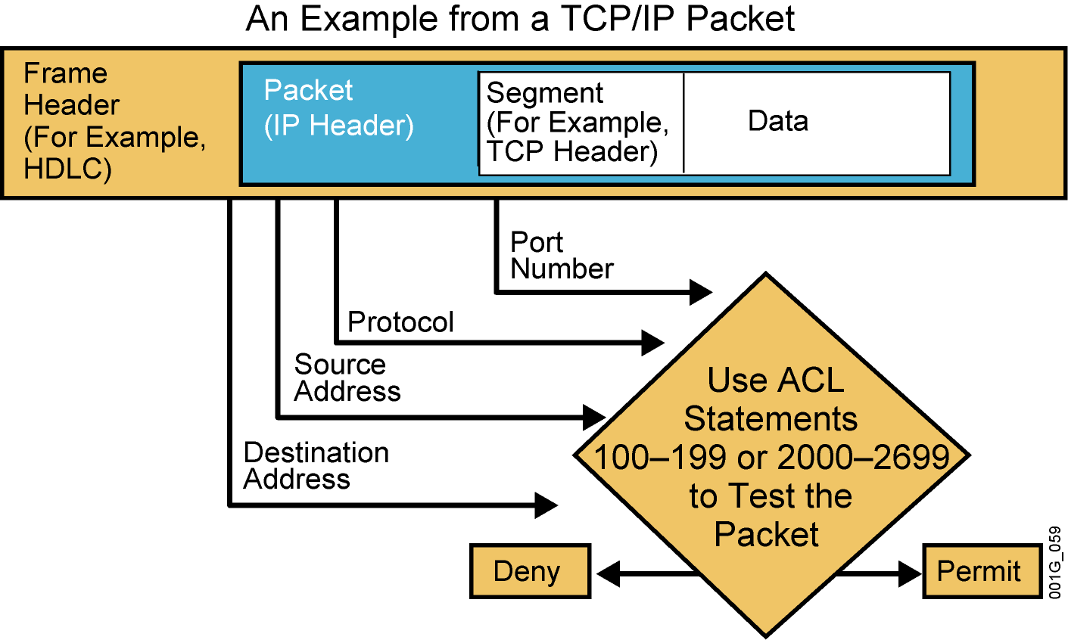
Testing Packets with
Numbered Extended IPv4 ACLs
Notes:
Purpose: This graphic gives an overview of the type of TCP/IP packet tests that extended access lists can filter. It uses the encapsulation graphic and diamond decision graphic to remind students of material presented earlier in this course.

Slide 22
Numbered Extended IPv4 ACL Configuration
RouterX(config)#
access-list access-list-number {permit | deny}
protocol source source-wildcard [operator port]
destination destination-wildcard [operator port]
[established] [log]
Sets parameters for this list entry
RouterX(config-if)#
ip access-group access-list-number {in | out}
Activates the extended list on an interface
Notes:
Layer 2 of 2
Purpose: Layer 2—Adds the access-group command for IP.
Emphasize: The list number must match the number (100 to 199) you specified in the access-list command.

Slide 23
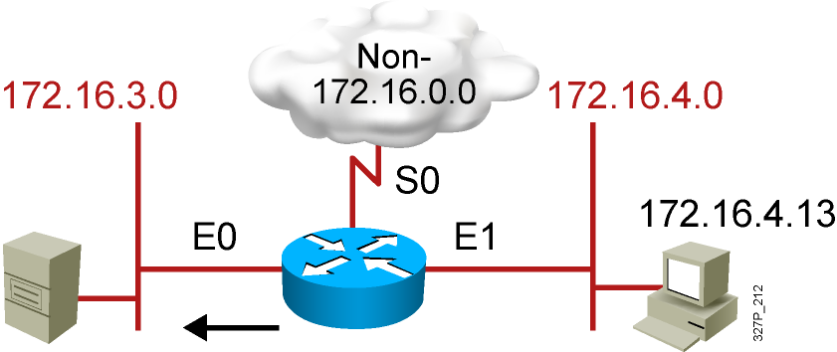
Numbered Extended IPv4 ACL
Example 1
RouterX(config)# access-list 101 deny tcp 172.16.4.0 0.0.0.255 172.16.3.0 0.0.0.255 eq 21
RouterX(config)# access-list 101 deny tcp 172.16.4.0 0.0.0.255 172.16.3.0 0.0.0.255 eq 20
RouterX(config)# access-list 101 permit ip any any
(implicit deny all)
(access-list 101 deny ip 0.0.0.0 255.255.255.255 0.0.0.0 255.255.255.255)
RouterX(config)# interface ethernet 0
RouterX(config-if)# ip access-group 101 out
Deny FTP traffic from subnet 172.16.4.0 to subnet 172.16.3.0 out E0
Permit all other traffic
Notes:
Layer 3 of 3

Slide 24
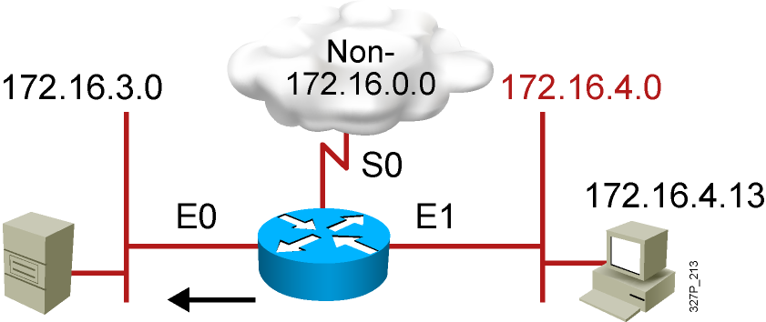
Numbered Extended IPv4 ACL
Example 2
RouterX(config)# access-list 101 deny tcp 172.16.4.0 0.0.0.255 any eq 23
RouterX(config)# access-list 101 permit ip any any
(implicit deny all)
RouterX(config)# interface ethernet 0
RouterX(config-if)# ip access-group 101 out
Deny only Telnet traffic from subnet 172.16.4.0 out E0
Permit all other traffic
Notes:
Layer 3 of 3

Slide 25
Named IP ACL Configuration
RouterX(config)#
ip access-list {standard | extended} name
Alphanumeric name string must be unique
RouterX(config {std- | ext-}nacl)#
[sequence-number] {permit | deny} {ip access list test conditions}
{permit | deny} {ip access list test conditions}
If not configured, sequence numbers are generated automatically starting at 10 and
incrementing by 10
no sequence number removes the specific test from the named ACL
RouterX(config-if)#
ip access-group name {in | out}
Activates the named IP ACL on an interface
Notes:
Layer 3 of 3
Purpose: Layer 3—Finishes with the new form of the access-group command, now able to refer to an IP access list name as well as an access list number.
Emphasize: Introduced with Cisco IOS Release 11.2, named access lists:
Intuitively identify IP access lists using alphanumeric identifiers.
Remove the limit on the number of access lists (previously 99 for IP standard and 100 for IP extended access lists).
Allow per-access-list statement deletions (previously the entire numbered access list needed to be deleted as a single entity).
Require Cisco IOS Release 11.2 or later.

Slide 26
Named Standard IPv4 ACL Example
RouterX(config)#ip access-list standard troublemaker
RouterX(config-std-nacl)#deny host 172.16.4.13
RouterX(config-std-nacl)#permit 172.16.4.0 0.0.0.255
RouterX(config-std-nacl)#interface e0
RouterX(config-if)#ip access-group troublemaker out
Deny a specific host
Notes:
Layer 2 of 2
Emphasize: All hosts on subnet 172.16.4.0 are blocked from going out on E0 to subnet 172.16.3.0.
Note: The red arrows represent the access list is applied as an outbound access list.

Slide 27

Named Extended IPv4 ACL Example
RouterX(config)#ip access-list extended badgroup
RouterX(config-ext-nacl)#deny tcp 172.16.4.0 0.0.0.255 any eq 23
RouterX(config-ext-nacl)#permit ip any any
RouterX(config-ext-nacl)#interface e0
RouterX(config-if)#ip access-group badgroup out
Deny Telnet from a specific subnet
Notes:
Layer 2 of 2
Emphasize: All hosts on subnet 172.16.4.0 are blocked from going out on E0 to subnet 172.16.3.0.
Note: The red arrows represent the access list is applied as an outbound access list.

Slide 28
Commenting ACL Statements
RouterX(config)#
ip access-list {standard|extended} name
Creates a named ACL
RouterX(config {std- | ext-}nacl)#
remark remark
Creates a named ACL comment
Or
RouterX(config)#
access-list access-list-number remark remark
Creates a numbered ACL comment

Slide 29
Monitoring ACL Statements
RouterX# show access-lists {access-list number|name}
RouterX# show access-lists
Standard IP access list SALES
10 deny 10.1.1.0, wildcard bits 0.0.0.255
20 permit 10.3.3.1
30 permit 10.4.4.1
40 permit 10.5.5.1
Extended IP access list ENG
10 permit tcp host 10.22.22.1 any eq telnet (25 matches)
20 permit tcp host 10.33.33.1 any eq ftp
30 permit tcp host 10.44.44.1 any eq ftp-data
Displays all access lists
Notes:
Purpose: This slide introduces the show access-lists command used to verify access lists.
Emphasize: This is the most consolidated method for seeing several access lists.
Note: The implicit deny all statement is not displayed unless it is explicitly entered in the access list.

Slide 30
Verifying ACLs
RouterX# show ip interfaces e0
Ethernet0 is up, line protocol is up
Internet address is 10.1.1.11/24
Broadcast address is 255.255.255.255
Address determined by setup command
MTU is 1500 bytes
Helper address is not set
Directed broadcast forwarding is disabled
Outgoing access list is not set
Inbound access list is 1
Proxy ARP is enabled
Security level is default
Split horizon is enabled
ICMP redirects are always sent
ICMP unreachables are always sent
ICMP mask replies are never sent
IP fast switching is enabled
IP fast switching on the same interface is disabled
IP Feature Fast switching turbo vector
IP multicast fast switching is enabled
IP multicast distributed fast switching is disabled
<text ommitted>
Notes:
240, 197, 102

Slide 31
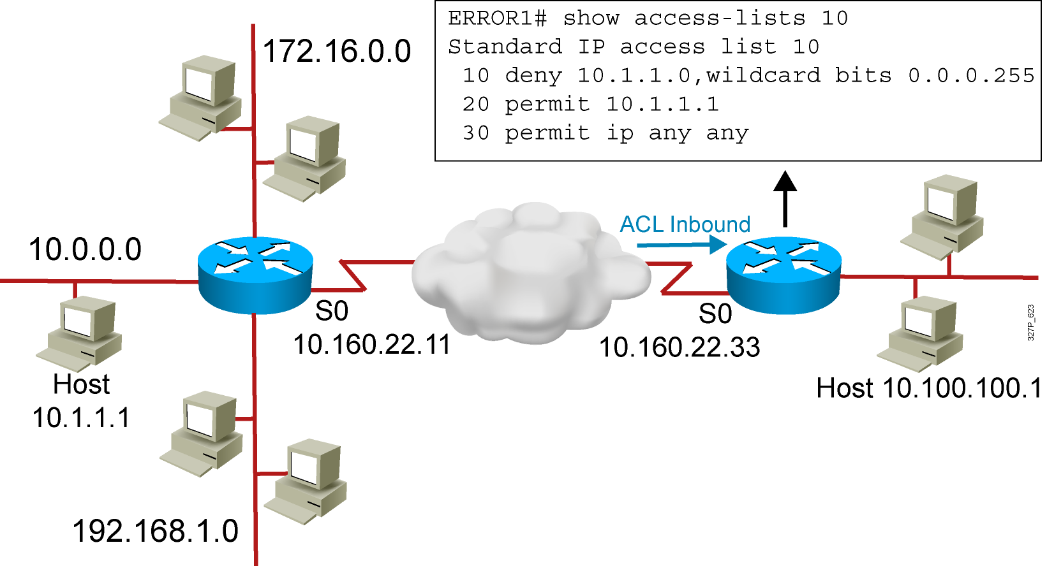
Troubleshooting Common ACL Errors
Error 1: Host 10.1.1.1 has no connectivity with 10.100.100.1.
Notes:
Layer 3 of 3
Purpose: Shows a deny result of the access list test.
Emphasize: Now the packet is discarded into the packet discard bucket. The unwanted packet has been denied access to the outbound interface.
The Notify Sender message shows a process like ICMP, returning an “administratively prohibited” message back to the sender.

Slide 32
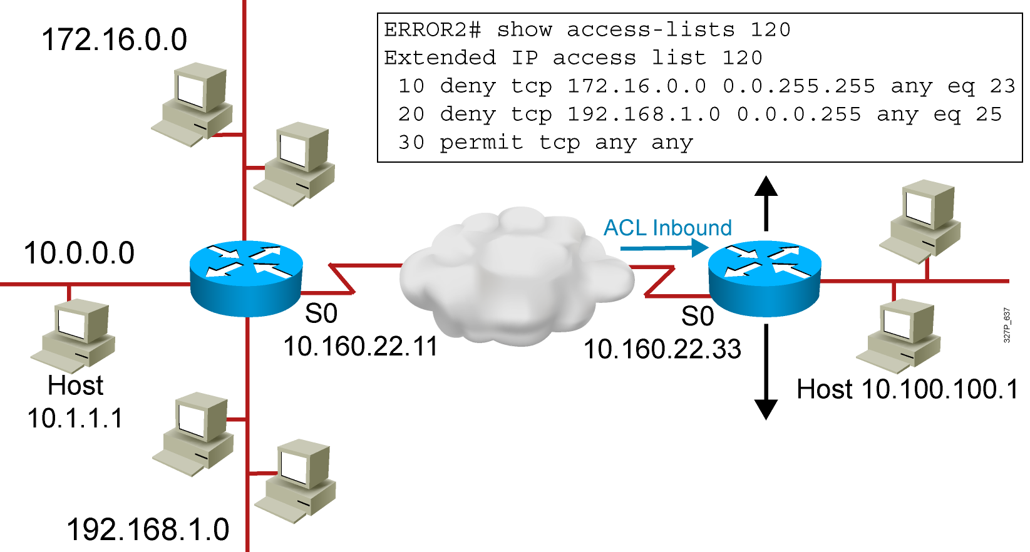
Troubleshooting Common ACL Errors (Cont.)
Error 2: The 192.168.1.0 network cannot use TFTP to connect to
10.100.100.1.
Notes:
Layer 3 of 3
Purpose: Shows a deny result of the access list test.
Emphasize: Now the packet is discarded into the packet discard bucket. The unwanted packet has been denied access to the outbound interface.
The Notify Sender message shows a process like ICMP, returning an “administratively prohibited” message back to the sender.

Slide 33
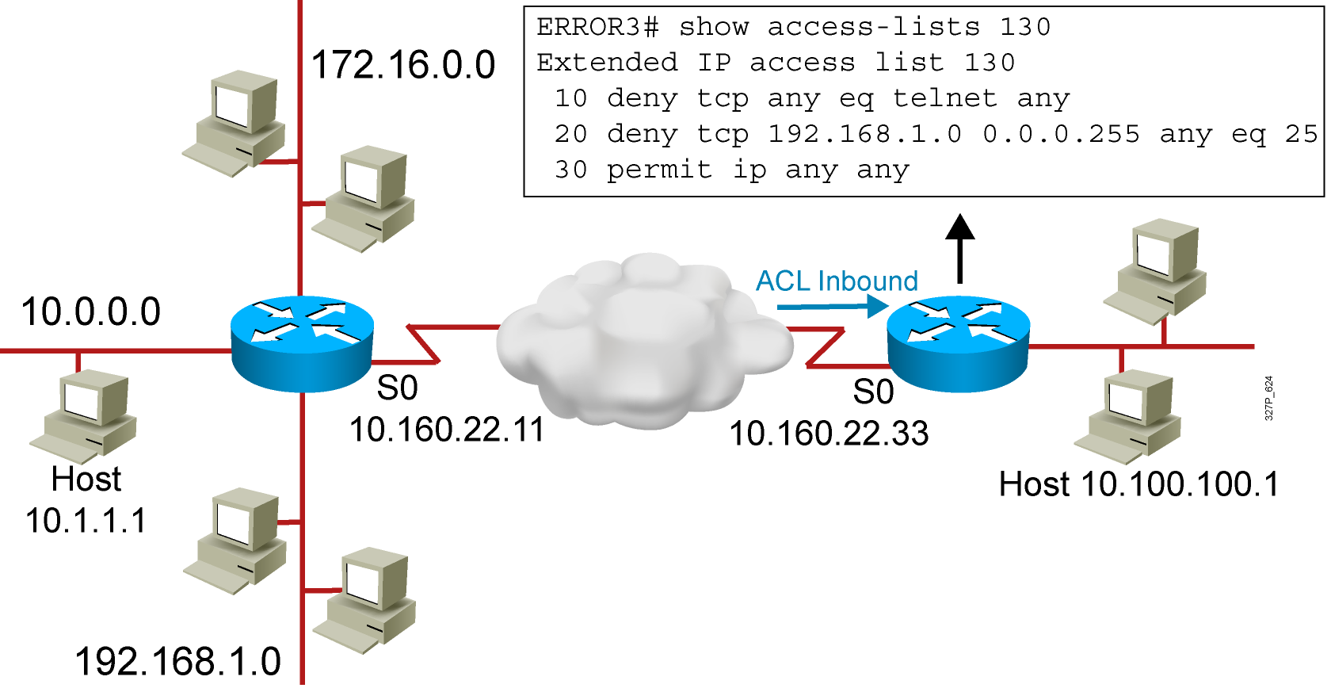
Troubleshooting Common ACL Errors (Cont.)
Error 3: 172.16.0.0 network can use Telnet to connect to 10.100.100.1,
but this connection should not be allowed.
Notes:
Layer 3 of 3
Purpose: Shows a deny result of the access list test.
Emphasize: Now the packet is discarded into the packet discard bucket. The unwanted packet has been denied access to the outbound interface.
The Notify Sender message shows a process like ICMP, returning an “administratively prohibited” message back to the sender.

Slide 34
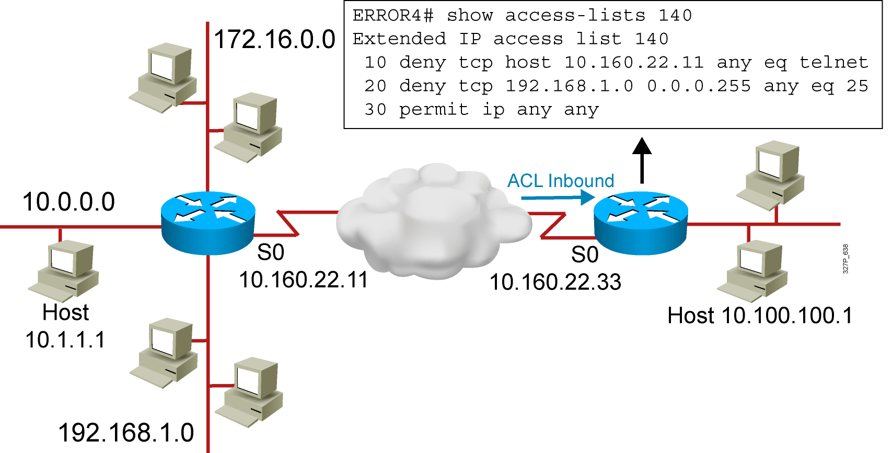
Troubleshooting Common ACL Errors (Cont.)
Error 4: Host 10.1.1.1 can use Telnet to connect to 10.100.100.1,
but this connection should not be allowed.
Notes:
Layer 3 of 3
Purpose: Shows a deny result of the access list test.
Emphasize: Now the packet is discarded into the packet discard bucket. The unwanted packet has been denied access to the outbound interface.
The Notify Sender message shows a process like ICMP, returning an “administratively prohibited” message back to the sender.

Slide 35
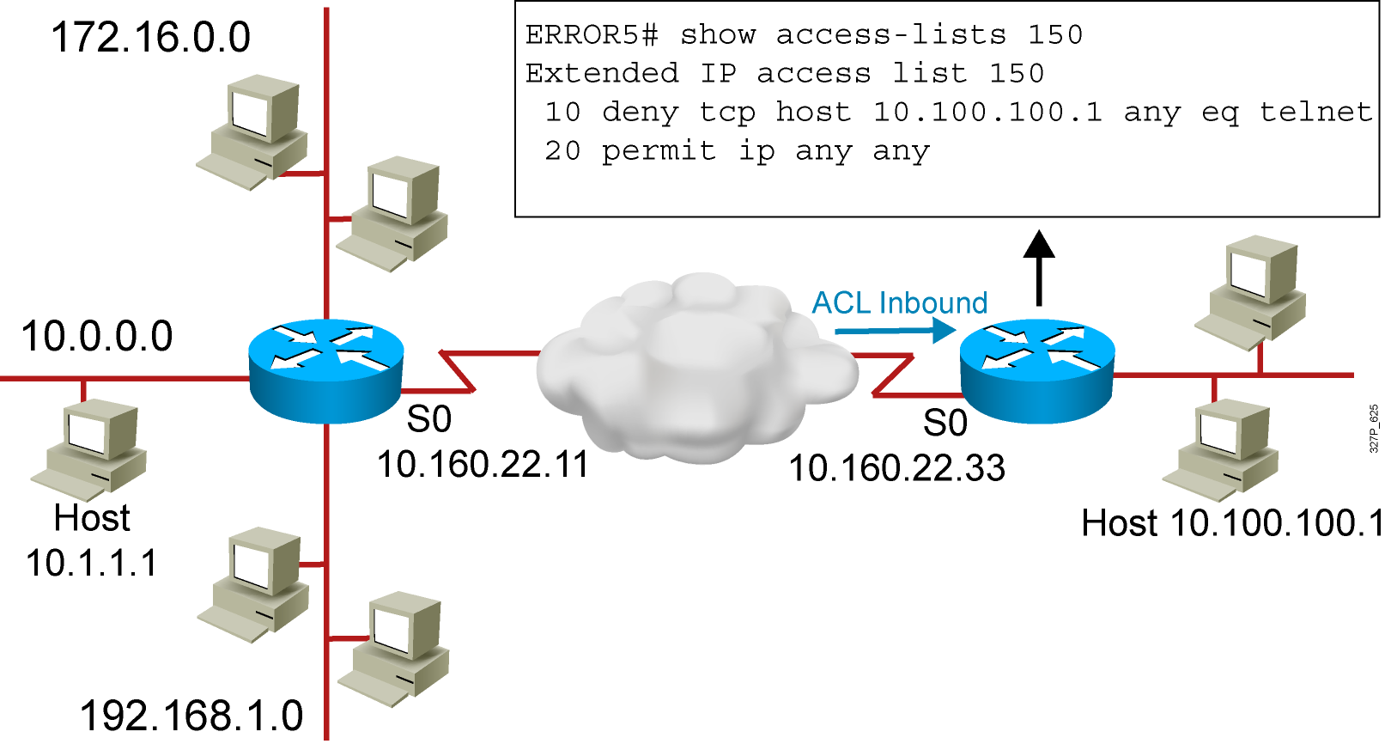
Troubleshooting Common ACL Errors (Cont.)
A
B
Error 5: Host 10.100.100.1 can use Telnet to connect to 10.1.1.1,
but this connection should not be allowed.
Notes:
Layer 3 of 3
Purpose: Shows a deny result of the access list test.
Emphasize: Now the packet is discarded into the packet discard bucket. The unwanted packet has been denied access to the outbound interface.
The Notify Sender message shows a process like ICMP, returning an “administratively prohibited” message back to the sender.

Slide 36
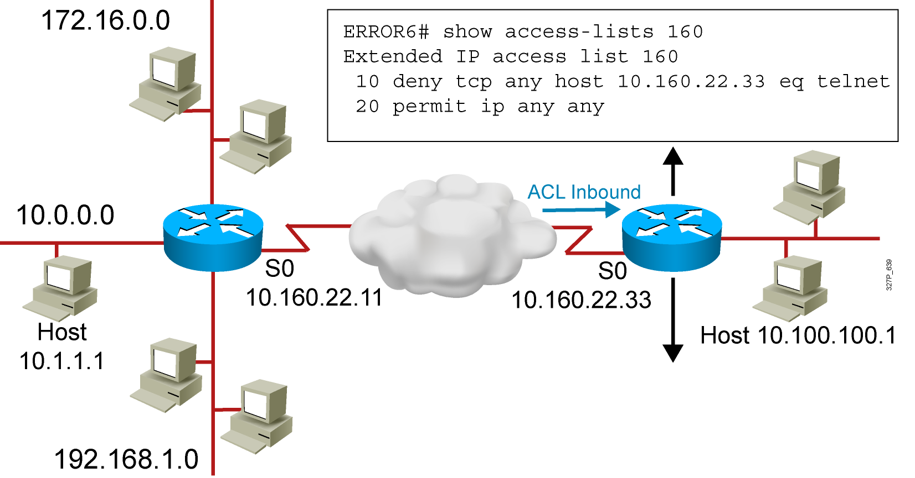
Troubleshooting Common ACL Errors (Cont.)
  A
  B
Error 6: Host 10.1.1.1 can use Telnet to connect into router B, but this connection should not be allowed.
Notes:
Layer 3 of 3
Purpose: Shows a deny result of the access list test.
Emphasize: Now the packet is discarded into the packet discard bucket. The unwanted packet has been denied access to the outbound interface.
The Notify Sender message shows a process like ICMP, returning an “administratively prohibited” message back to the sender.

Slide 37
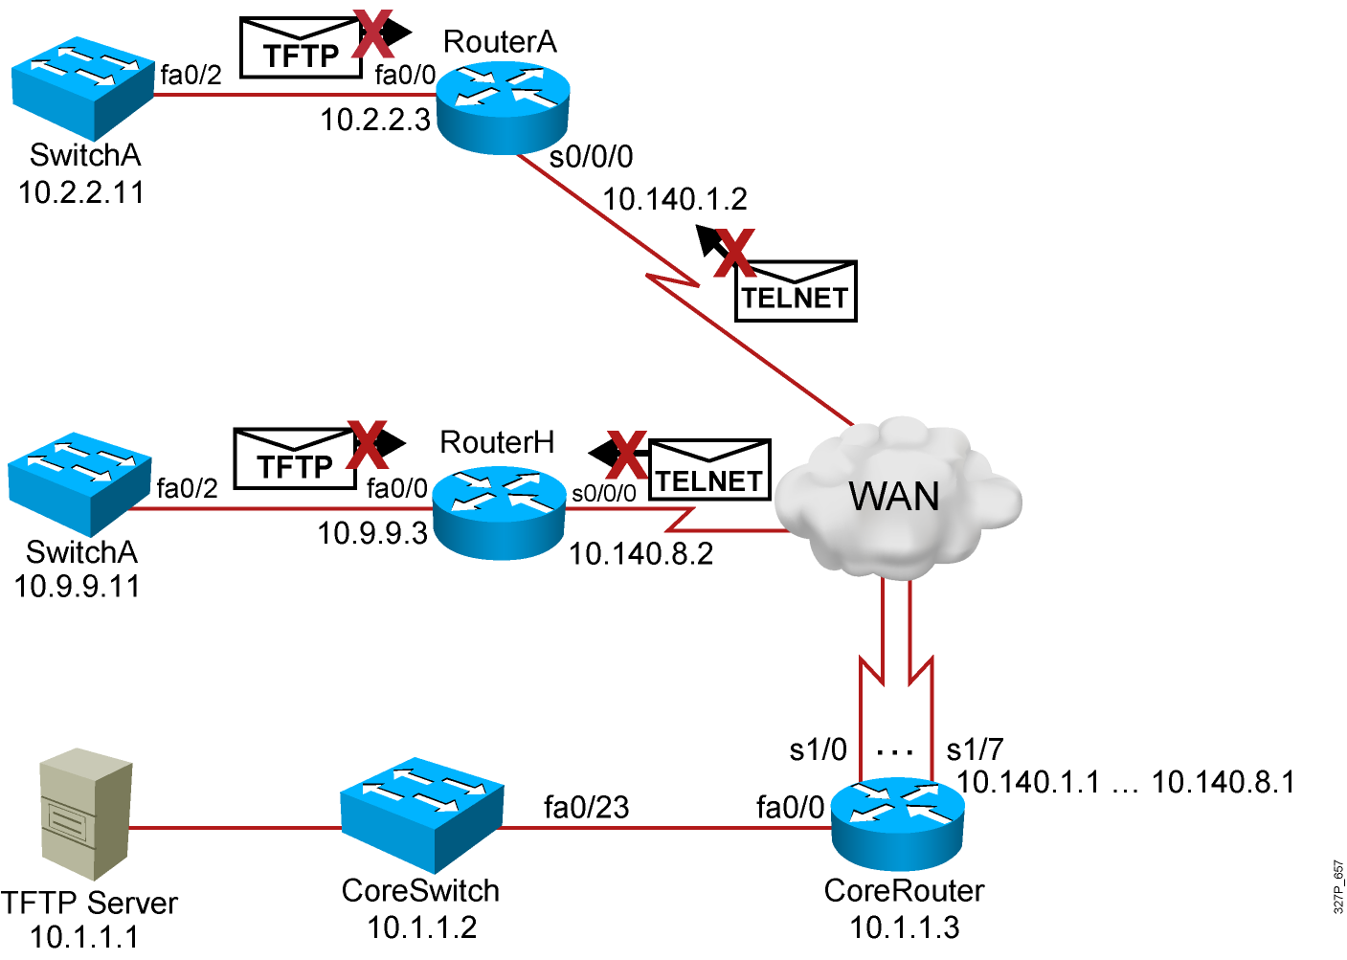
Visual Objective 6-1: Implementing and Troubleshooting ACLs
WG Router s0/0/0 Router fa0/0 Switch
A 10.140.1.2 10.2.2.3 10.2.2.11
B 10.140.2.2 10.3.3.3 10.3.3.11
C 10.140.3.2 10.4.4.3 10.4.4.11
D 10.140.4.2 10.5.5.3 10.5.5.11
E 10.140.5.2 10.6.6.3 10.6.6.11
F 10.140.6.2 10.7.7.3 10.7.7.11
G 10.140.7.2 10.8.8.3 10.8.8.11
H 10.140.8.2 10.9.9.3 10.9.9.11
SwitchH
Notes:
Lab 13 ACL
Note: Refer to the lab setup guide for lab instructions.

Slide 38
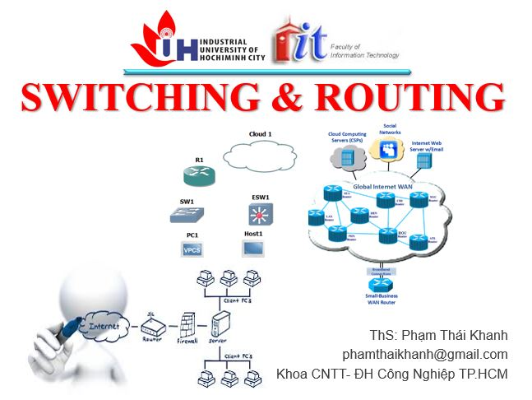


phamthaikhanh@gmail.com
This Photo by Unknown Author is licensed under CC BY-NC

